Slide 1
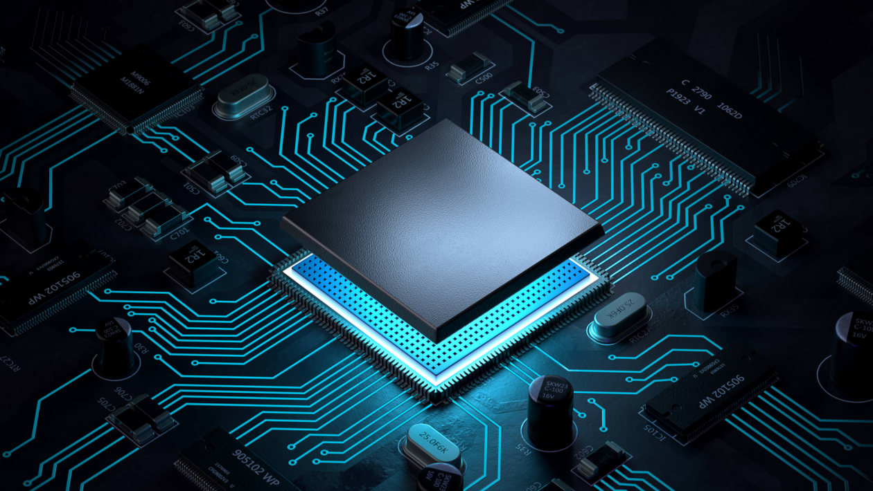

EMBEDDED SYSTEM AND ARM
ASSOCIATES,
G .TEJA
MALAVIKA SURESH
CH. ADITYA MANOHAR
BHARGAV ROHIT

Slide 2
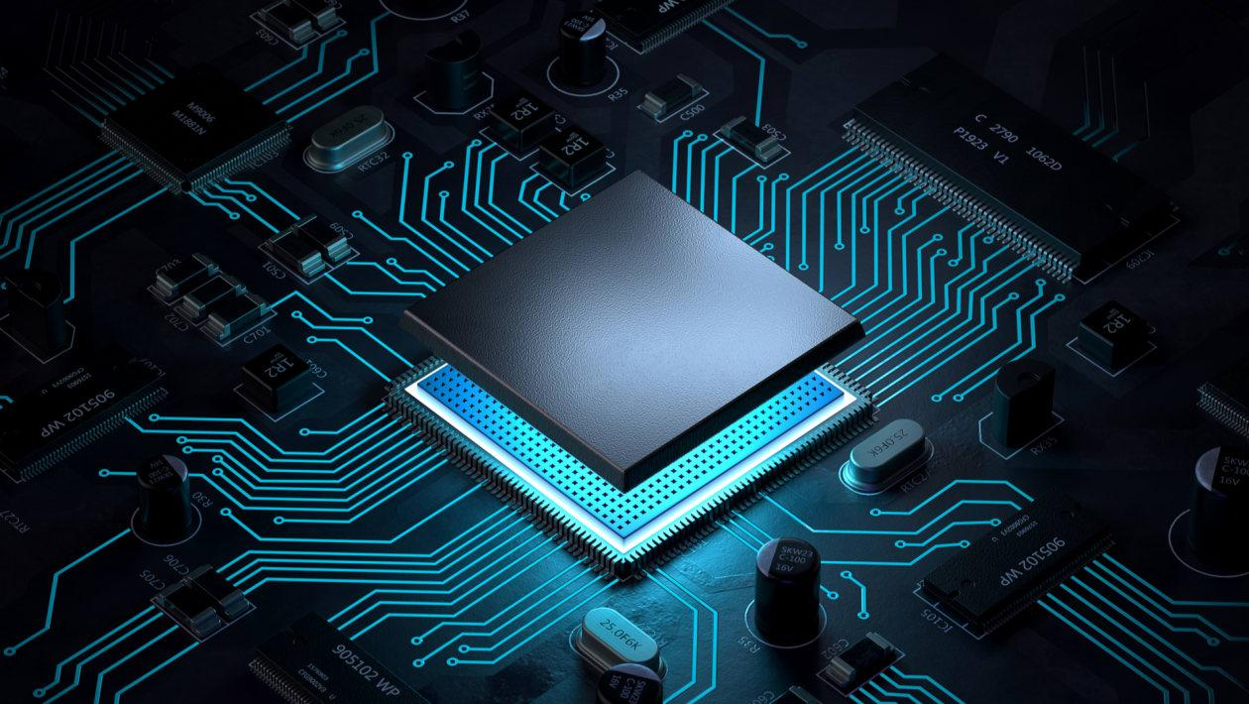
Embedded Systems
Embedded Sysytems
BY……
TEJA

Slide 3
Contents:
Embedded System
Architecture
Types
Characteristics
Applications
Advantages and Disadvantages
Processor
Microprocessor
Microcontroller
Difference between Microprocessor and Microcontroller
Classification of microprocessor
Difference between RISC and CISC

Slide 4
Continued..
Pipeline
Arm Processor
ARM Architecture
LPC2148 microcontroller
Features of LPC2148
Pin configuration LPC2148
Applications of LPC2148
Kernel
Arm processor in Automotive
Sample programs

Slide 5
What is an Embedded system?
An embedded system is one that has computer hardware with software embedded in it as one of its components.
Or
We can defined it as “It is a combination of hardware and software to do specific task
An embedded system is a special purpose computer system designed to perform certain dedicated functions.It is usually embedded as part of a complete device including hardware and mechanical parts.
An embedded system is one that has computer hardware with software embedded in it as one of its components.
Or
An embedded system is one that has computer hardware with software embedded in it as one of its components.
OR
We can define it as “It is a combination of hardware and software to do specific task”.
An embedded system is a special purpose computer system designed to perform certain dedicated functions. It is usually embedded as part of a complete device including hardware and mechanical parts.

Slide 6
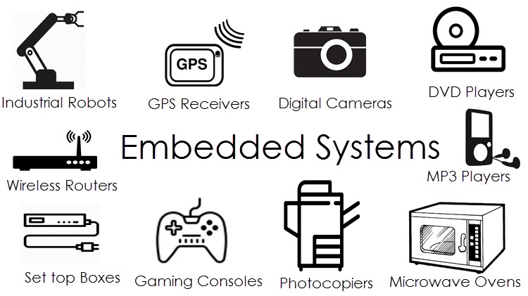
Examples of embedded systems

Slide 7
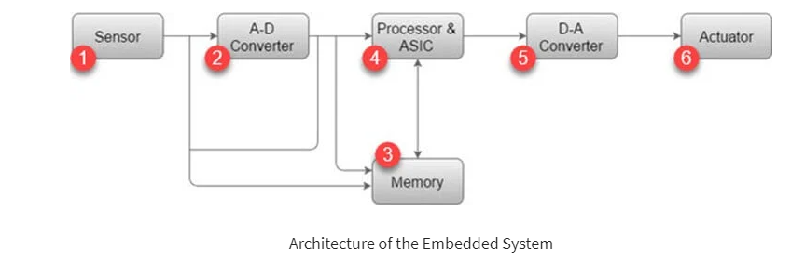
Architecture of the Embedded System

Slide 8
SENSOR:
Sensor helps you to measures the physical quantity and converts it to an electrical signal.
It also stores the measured quantity to the memory.
This signal can be ready by an observer or by any electronic instrument such as A2D converter.
A-D CONVERTER:
A-D converter (analog-to-digital converter) allows you to convert an analog signal sent by the sensor into a digital signal.
MEMORY:
Memory is used to store information. Embedded System majorly contains two memory cells 1) Volatile 2) Non volatile memory.

Slide 9
PROCESSOR & ASICs:
This component processes the data to measure the output and store it to the memory.
D-A CONVERTER:
D-A converter (A digital-to-analog converter) helps you to convert the digital data fed by the processor to analog data.
ACTUATOR:
An actuator allows you to compare the output given by the D-A converter to the actual output stored in it and stores the approved output in the memory.

Slide 10
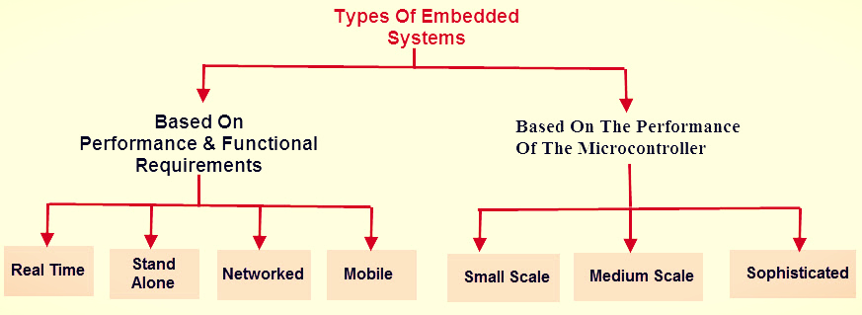
Types of Embedded System

Slide 11
Based on performance and functional requirements:
Real Time Embedded Systems
A real time embedded system is defined as, a system which gives a required o/p in a particular time.
These types of embedded systems follow the time deadlines for completion of a task.
Real time embedded systems are classified into two types such as soft and hard real time systems.
Stand Alone Embedded Systems:
Stand alone embedded systems do not require a host system like a computer, it works by itself.
It takes the input from the input ports either analog or digital and processes, calculates and converts the data and gives the resulting data through the connected device-Which it either controls, drives and displays the connected devices.
Examples for the stand alone embedded systems are mp3 players, digital cameras, video game consoles, microwave ovens and temperature measurement systems.

Slide 12
Networked Embedded Systems
These types of embedded systems are related to a network to access the resources.
The connected network can be LAN, WAN or the internet. The connection can be any wired or wireless. This type of embedded system is the fastest growing area in embedded system applications.
The embedded web server is a type of system wherein all embedded devices are connected to a web server and accessed and controlled by a web browser.
Example for the LAN networked embedded system is a home security system wherein all sensors are connected and run on the protocol TCP/IP
Mobile Embedded Systems
Mobile embedded systems are used in portable embedded devices like cell phones, mobiles, digital cameras, mp3 players and personal digital assistants, etc.
The basic limitation of these devices is the other resources and limitation of memory.

Slide 13
Based on performance of microcontroller:
Small Scale Embedded Systems
These types of embedded systems are designed with a single 8 or 16-bit microcontroller, that may even be activated by a battery.
For developing embedded software for small scale embedded systems, the main programming tools are an editor, assembler, cross assembler and integrated development environment (IDE).
Medium Scale Embedded Systems
These types of embedded systems design with a single or 16 or 32 bit microcontroller, RISCs or DSPs.
These types of embedded systems have both hardware and software complexities.

Slide 14
Continued
For developing embedded software for medium scale embedded systems, the main programming tools are C, C++, JAVA, Visual C++, RTOS, debugger, source code engineering tool, simulator and IDE.
Sophisticated Embedded Systems
These types of embedded systems have enormous hardware and software complexities, that may need ASIPs, IPs, PLAs, scalable or configurable processors.
They are used for cutting-edge applications that need hardware and software Co-design and components which have to assemble in the final system.

Slide 15
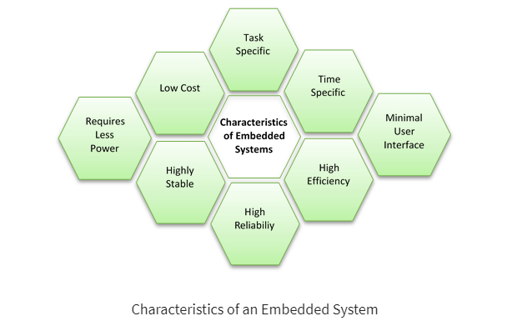
Characteristics of an embedded system

Slide 16
Applications of Embedded Systems
Robotic science
Ground Vehicles
Drones
Underwater Vehicles
Industrial Robots
Medical
Dialysis Machine
Infusion Pumps
Cardiac Monitor
Prosthetic Device
Automotive
Engine Control
Ignition System
Brake System
Networking
Router
Hubs
Gateways
Electronics Instruments
Home Devices
TVs
Digital Alarm
Air Conditioner
DVD Video Player

Slide 17
Advantages of Embedded System
Embedded System simplified hardware which, which reduces costs overall.
It has very few interconnections.
The embedded system is small in size.
It has a fast operation.
It has a low power operation.

Slide 18
Disadvantages of Embedded System
Embedded systems do a very specific task, so it can’t be programmed to do different things.
It is difficult to backup of embedded files.
To develop an embedded system needs high development effort.
Embedded systems offer very limited resources for memory.
It needs a long time to market.

Slide 19
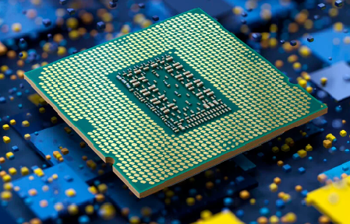
Processor
Processor is heart of Embedded system.
An embedded processor is a microprocessor
that is used in an embedded system.
For an embedded system designer know
knowledge of microprocessor and
microcontroller is must.

Slide 20
MICROPROCESSOR:
A microprocessor is basically the brain of the computer. We can also call it simply a processor or CPU.
Furthermore, a microprocessor is basically a computer processor that is mounted on a single IC (Integrated Circuit).
It means that all the functions of the processor are included on a single chip.
Example: microwaves, toasters, televisions, VCRs, DVD players, ovens, stoves, clothes washers, home computers, alarm clocks, hand-held game devices, thermostats, video game systems, bread machines, dishwashers etc.

Slide 21
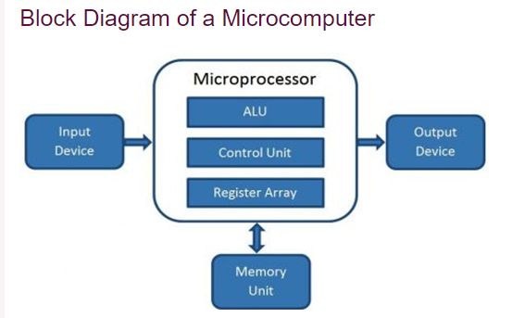
Block diagram of Microprocessor :
A microprocessor consists of an ALU, control unit and register array.
Where ALU performs arithmetic and logical operations on the data received from an input device or memory.
Control unit controls the instructions and flow of data within the computer.
And, register array consists of registers identified by letters like B, C, D, E, H, L, and accumulator.

Slide 22
MICROCONTROLLERS:
A microcontroller is a single integrated circuit that comprises various elements, including a microprocessor, timers, counters, input/output (I/O) ports, random access memory (RAM), read-only memory (ROM), and some other components.
These parts work together to execute a pre-programmed set of specific tasks.
Thus, a microcontroller is like a little computer that processes and even executes control in an electronic device.
Example: Light sensing & controlling devices, Temperature sensing and controlling devices, Fire detection & safety devices, Industrial instrumentation devices, Process control devices.

Slide 23
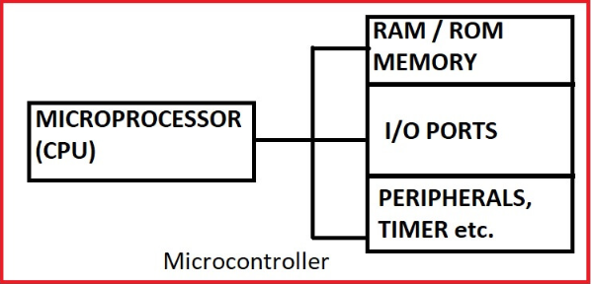
Block diagram of microcontroller:
The word microprocessor means a CPU only.
The functional blocks like memory and other
peripherals are to be connected externally
to a microprocessor chip to make a complete
microcomputer.
The microcontrollers are having all these
facilities in a single chip.
The microcontrollers are used for general
purpose applications in the sense that they
are user programmable.

Slide 24
Difference Between Microprocessor and Microcontroller
Microprocessor | Microcontroller
Microprocessor act as heart of computer. | Microcontroller act as heart of embedded system.
It is a processor in which memory and I/O output component is connected externally. | It is a controlling device in which memory and I/O output component is present internally.
Microprocessor has less number of registers. Therefore most of the operations are memory based. | Microcontroller has more number of registers. Therefore a program is easier to write.
It’s complex and expensive, with a large number of instructions to process. | It’s simple and inexpensive with less number of instructions to process.
It is mainly used in personal computers. | It is used mainly in a washing machine, MP3 players, and embedded systems.

Slide 25
Classification Of Microprocessor
Based on architecture microprocessor is categorized into
RISC and CISC processor
RISC: Reduced instruction set computing
Risc based machines executes one instruction per clock cycle.
In RISC processor every instruction also has a fixed memory size which make them easier to decode and execute.
CISC: Complex instruction set computing
In CISC processor each instruction performs so many tasks it takes several clock cycles to complete.
In CISC machines the instructions can be variable lengths, which increases the processing time.

Slide 26
Difference between RISC and CISC architecture as follows:
RISC | CISC
Simple, standardised instructions | Complex, variable length instructions
Heavy use of RAM | More efficient use of RAM
Emphasis on software | Emphasis on hardware
Pipelining is easy | Pipelining is difficult
Fewer addressing modes | More addressing modes
Complexity in compiler | Extensive use of microprogramming
Examples: ARM, PA-RISC, Power Architecture, Alpha, AVR, ARC and the SPARC | Examples: VAX, Motorola 68000 family, System/360, AMD and the Intel x86 CPUs.

Slide 27
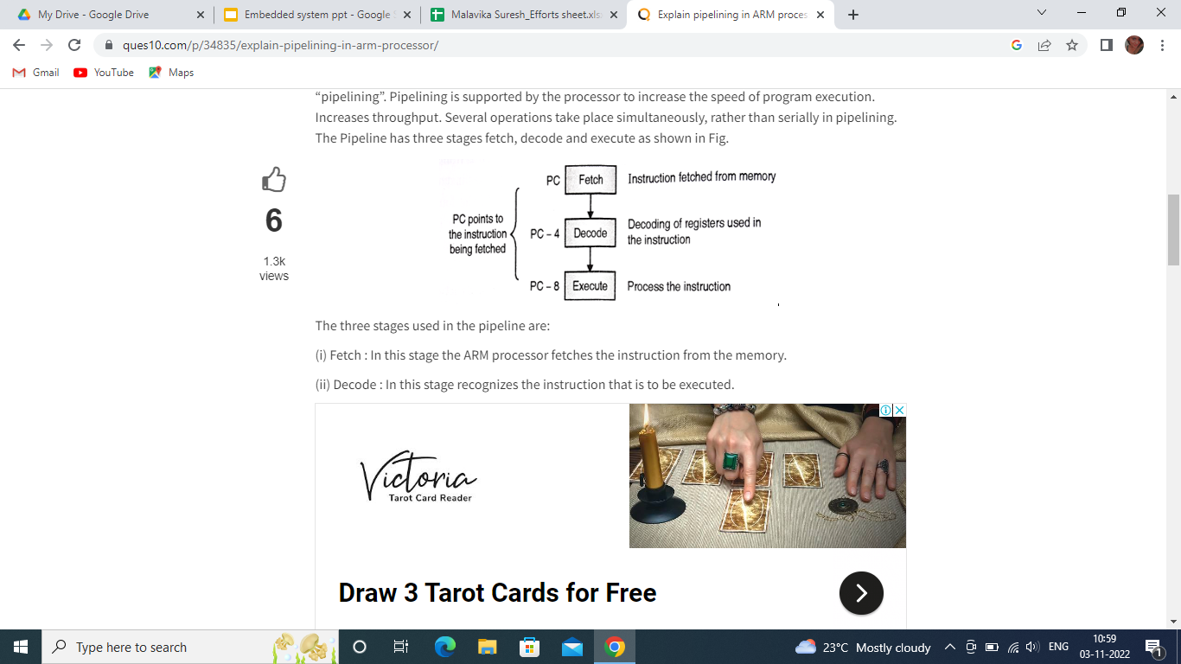
Pipeline
The Process of fetching the next instruction while the current instruction is being executed is called as “pipelining”.
A Pipelining is the mechanism used by RISC(Reduced instruction set computer) processors to execute instructions.
The Pipeline has three stages fetch, decode and execute as shown in the figure.
Instruction fetched from memory
PC points to the instruction being fetched
Decoding of registers used in the instruction
Process the instruction

Slide 28
The three stages used in the pipeline are:
(i) Fetch : In this stage the ARM processor fetches the instruction from the memory.
(ii) Decode : In this stage recognizes the instruction that is to be executed.
(iii) Execute : In this stage the processor processes the instruction and writes the result back to desired register.
If these three stages of execution are overlapped, we will achieve higher speed of execution.
Such pipeline exists in version 7 of ARM processor.
Once the pipeline is filled, each instructions requires one cycle to complete execution.

Slide 29
Types of Pipeline
It is divided into 2 categories:
1. Arithmetic Pipeline
2. Instruction Pipeline
Arithmetic Pipeline:
Arithmetic pipelines are usually found in most of the computers. They are used for floating point operations, multiplication of fixed point numbers etc.
Instruction Pipeline:
An instruction pipeline reads instruction from the memory while previous instructions are being executed in other segments of the pipeline. This type of technique is used to increase the throughput of the computer system.

Slide 30
Advantages of Pipeline
1. The cycle time of the processor is reduced.
2. It increases the throughput of the system.
3. It makes the system reliable.
4. Faster ALU can be designed when pipelining is used.
5. Pipelining increases the overall performance of the CPU.

Slide 31
Disadvantages of pipeline
1. The design of pipelined processor is complex and costly to manufacture.
2. The instruction latency is more.
3. The throughput of a pipelined processor is difficult to predict.
4. The longer the pipeline, worse the problem of hazard for branch instructions.

Slide 32
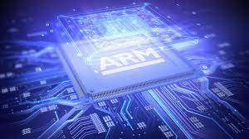
ARM PROCESSOR
ARM PROCESSOR
BY
MALAVIKA SURESH
By
Malavika Suresh

Slide 33
ARM
The ARM processor is an Advanced Reduced Instruction Set Computer [RISC] Machine.
It’s a 32bit Reduced Instruction Set Computer (RISC) Machine.
Acorn Computers first developed ARM in 1980. It is a microprocessor design company, founded in 1990 by Hermann Hauser.
ARM limited offers for both 32bit and 64bit RISC microprocessors.
The ARM keeps the processor’s information set small.
ARM family offers high performance for very low power consumption.
A characteristic feature of ARM processors is their low electric power consumption.

Slide 34
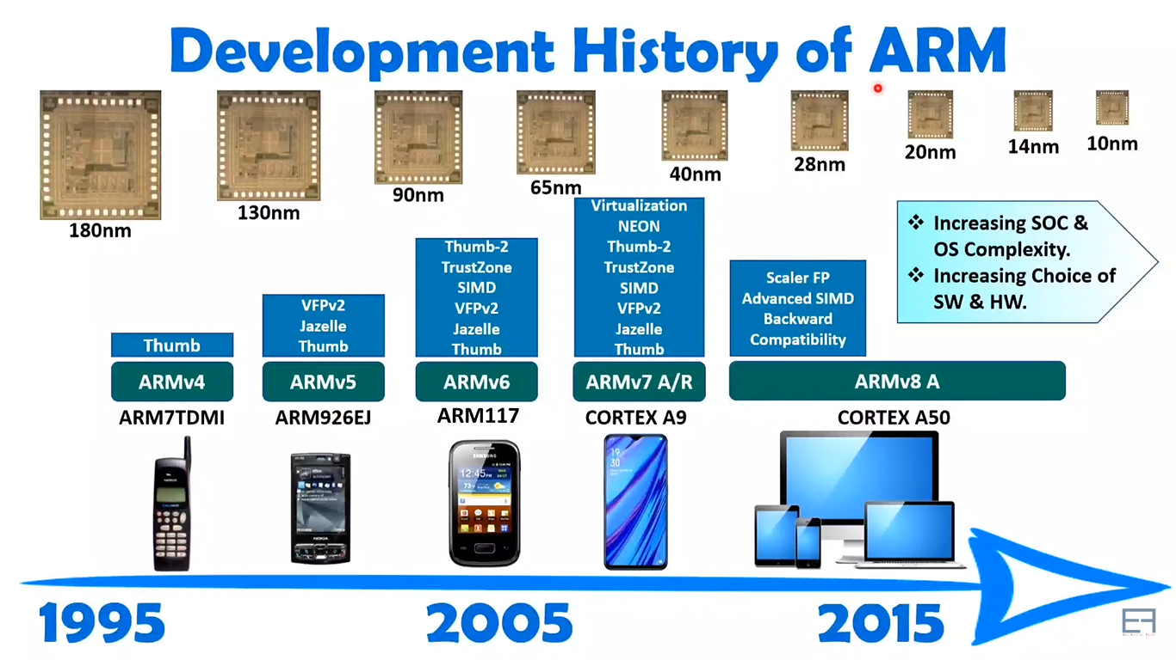

Slide 35
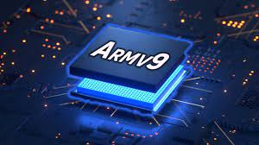
Armv9 – The Next Generation of Arm Architecture.
Armv9-A is a set of extensions to the Armv8-A architecture.
The goal of these enhancements is to help increase the computing capability in areas such as digital signal processing (DSP) and machine learning (ML), and to continually improve the security of our systems.

Slide 36
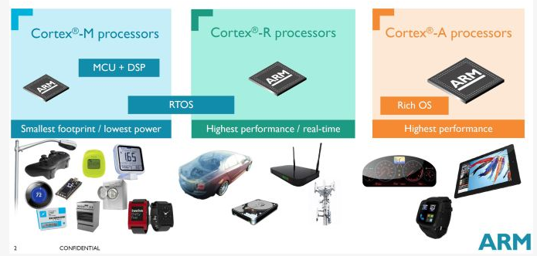
ARM PRODUCTS

Slide 37
FEATURES OF ARM PROCESSOR
A load-store architecture.
Fixed length 32-bit instructions.
3-address instruction format.
-Use each address field to specify either a processor registered a memory operand (ADD R1, R2, R3).
High code density.
32-bit architecture till V7.

Slide 38
ARM 7
ARM7 is a group of 32-bit RISC ARM processor cores.
The ARM7TDMI and ARM7TDMI-S were the most popular cores of the family.
All these designs use a von Neumann architecture.
The processor supports both 16 bit and 32 bit instructions.
Since ARM7 cores were released from 1993 to 2001, they are no longer recommended for new IC designs.

Slide 39
ARM7TDMI processor is a member of the advanced RISC Machine family, licensed for manufacture by an array of semiconductor companies.
It stands for ARM7-Advanced Risc machine.
T - THUMB architecture extension
D- debug extension
M-enhanced multiplier
I-Interface

Slide 40
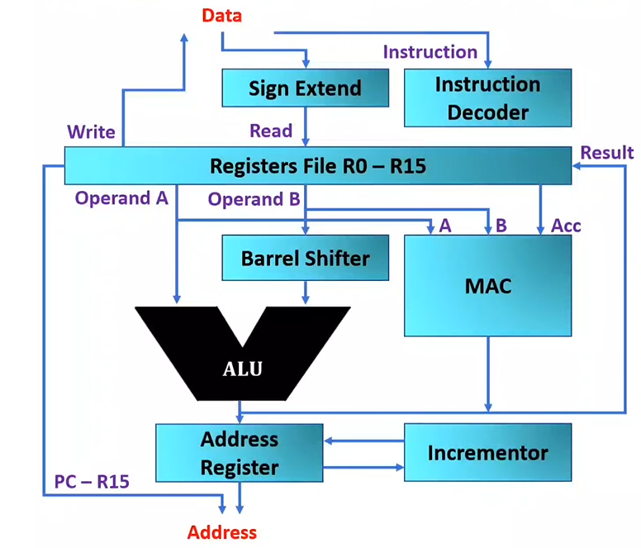
ARM ARCHITECTURE
ALU
Register File
Barrel Shifter
MAC
Address Bus and Data Bus
Instruction Decoder
Address Register

Slide 41
Arithmetic Logic Unit (ALU)
The ALU has two 32-bits inputs.
The primary comes from the register file, whereas the other comes from the shifter.
Status registers flags modified by the ALU outputs.
The ALU has a 4-bit function bus that permits up to 16 opcode to be implemented.

Slide 42
Barrel Shifter
It is used to pre shift operand before it is given to ALU.
It is a combination of logic shifter, it can shift multiple shift in one clock cycle.
It can be used with single register also for shifting and rotating the data of register.
It can also be used for scaled addressing.

Slide 43
MAC- Multiply Accumulate
It is used to perform multiplication operation with accumulation.
Example: MLA, R0, R1, R2, R3.
After execution: R0=R1*R2+R3
Control Unit
For any microprocessor, control unit is the heart of the whole process and it is responsible for the system operation
The control unit is sometimes a pure combinational circuit design.
Here, the control unit is implemented by easy state machine.
The processor timing is additionally included within the control unit.
Signals from the control unit are connected to each component within the processor to supervise its operation.

Slide 44
Registers Files
R0 - R15 are 32 bits GPRs, among them some are special registers.
ARM has total 37 Registers of 32 bits.
Only 16 registers are visible for a specific mode.
A mode could access
-A particular set of R0-R12
-R13(sp, stack pointer)
-R14(lk, link pointer)
-R15(pc, program counter)
-current program status register(cpsr)

Slide 45
Program Counter
PC indicates address of next instruction ie, it store the address of the instruction to be executed.
PC is periodically incremented after every instruction is fetched.
All instructions are 32-bit wide and word-aligned.
Thus, the last two bits of pc are undefined.
Interrupts
Every peripheral device consists of a single interrupt line allied to the VIC (vector interrupt controller), although it can have various interrupt flags inside.

Slide 46
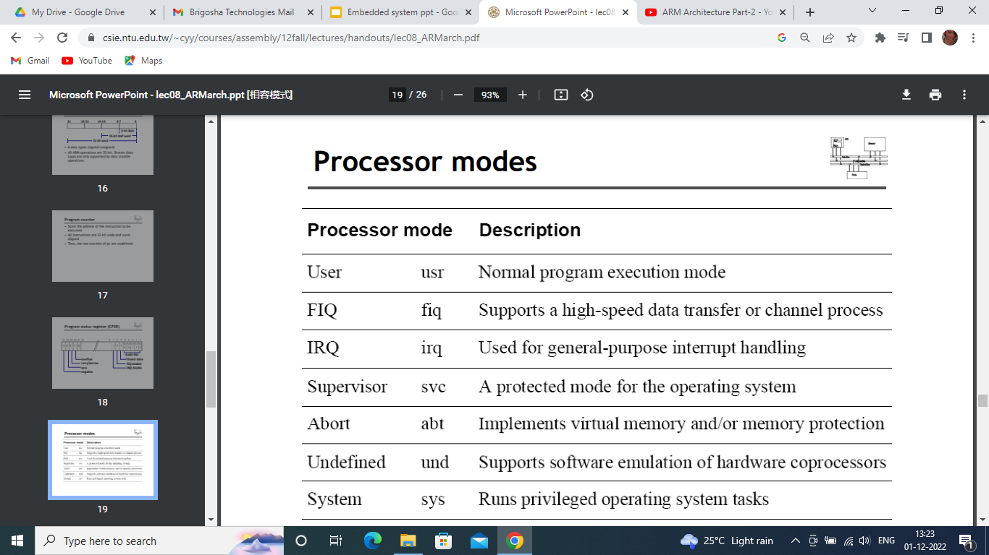

Slide 47
APPLICATIONS Of ARM
iPod from Apple.
D-link DSL -604+ wireless ADSL router.
Many automobiles embedded ARM7 cores.
Sirius satellite Radio receivers.
Most of Nokia's mobile phone range

Slide 48
Features of LPC2148
By
Ch . Aditya Manohar

Slide 49
ARM7 Based LPC2148 Microcontroller
LPC2148 is a 16-bit or 32-bit microcontroller based on ARM7 family.
The LPC2148 microcontroller is designed by Philips (NXP Semiconductor) with several in-built features & peripherals.
Due to these reasons, it will make more reliable as well as the efficient option for an application developer.

Slide 50
FEATURES OF LPC2148
PACKAGE:
16/32 bit ARM7TDMI -S microcontroller in a tiny LQFP64 package.
MEMORY:
40kB of on-chip static RAM.
512 kB of on chip flash program memory.
SPEED:
128 bit wide interface/accelerator enables high speed 60 MHz operation

Slide 51
In-System/In-application programming (ISP/IAP) via on -chip boot -loader software.
Single flash sector or full chip erase in 400 ms and programming of 256 bytes in 1ms.
USB 2.0 full speed complaint Device controller with 2kB of endpoint RAM.
In addition, the LPC2148 provides 8kB of on-chip RAM
ADC:
Two 10-bit A/D converters (AD0 and AD1) provide a total of 14 analog inputs.
Conversion times as low as 2.44μs per channel.

Slide 52
DAC:
Single 10 bit D/A converter provides a variable analog output.
TIMERS:
Two 32 bit timers /external event counters.
Each timer with four capture and four compare channels.
PWM units(six outputs).
Watchdog timer.
RTC:
Low power real-time clock with independent power and dedicated 32 kHz clock input.

Slide 53
SERIAL INTERFACES:
I2C- bus:Two Fast I2C- bus with 400 kbit/s.
Serial communication :Two UARTs(16C550).
SPI(serial peripheral interface)and SSP(Synchronous serial port) with buffering and variable data length capablities .
FAST GPIO:
Upto 45 of 5 V tolerant fast general purpose I/O pins in a tiny LQFP64.
INTERRUPTS:
Vectored interrupt controller with 16 configurable priorities and vector addresses.
9 edge or level sensitive external input pins are available.

Slide 54
60MHz maximum CPU clock available from programmable on-chip PLL with settling time of 100μs.
OSCILLATOR :On chip integrated oscillator operates with an external crystal in range from 1 MHz to 30 MHz and with an external oscillator up to 50 MHz.
POWER SAVING MODE:
Idle mode
Power down mode
CPU operating voltage range of 3.0 V to 3.6 V with 5 V tolerant I/O pads.

Slide 55
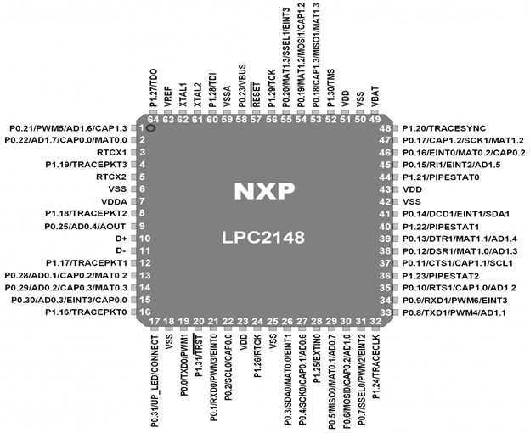
Pin configuration of LPC2148 Microcontroller

Slide 56
GPIO Pins Details
Pin1 (P0.21/PWM5/AD1.6/Cap1.3):
It is a general-purpose pin and it could be used for four multiple ways such as it could be as input output data pin, as a pulse width modulation generator, as an analog to digital converter and as a capture input for timer l channel 3.
Pin 2 (P0.22/AD1.7/CAP0.0/MAT0.0):
It could be for used for four purposes. First one P0.21, it could be used for input output data pin, second one AD1.7 , it could be used as analog to digital converter with ADC 1, input 7.
Third one CAP0.0,it could be used as a capture input for timer 0 and channel 0. Fourth one MAT 0.0, it could be used as match output for timer 0 and channel 0.

Slide 57
Pin 3 (RTC X1): Pin3 is used as input pin for RTC oscillator circuit.
Pin 4 (P1.19/TRACEPKT3): Pin 4 could be as GPIO pin as well as with 3 bit input output pin for inner pull up.
Pin 5 (RTCX2): Pin 4 is used as output pin for RTC oscillator circuit.
Pin(6,18,25,42,50): These pins are used as references pins for grounding the microcontroller.
Pin7(VDDA): This pin is used as voltage source pin with 3.3 Volts. These voltages could be useful for on chip digital to analog converter and analog to digital converter.
Pin8(P1.18/TRACEPKT2): This pin is used as GPIO pin and 2 bit input output pin for inner pull up.

Slide 58
Pin9(P0.25/AD0.4/AOUT): This pin is used as GPIO pin, as input 4 for AD0 and as output pin for digital to analog converter.
Pin(10,11): Pin10 is used for D+ line bidirectional USB. Similarly the pin11 is used for D-line bidirectional USB.
Pin12(P1.7/TRACEPKT1): This pin is used as a GPIO pin and as a standard input/output port for inner pull up.
Pin 13 (P0.28/AD0.1/CAP0.2/MAT0.2): This pin is used as a GPIO pin, analog to digital converter pin for ADC-0 input 1, capture input pin for timer 0 channel 2 and as a match output pin for timer 2 channel 1.
Pin 14(P0.29/AD0.2/CAP0.3/MAT0.3): This pin could be used as a GPIO pin, converter input pin for ADC-0 input 2,capture input for timer 0 channel 3 and as a match output pin for timer 0 channel 3.

Slide 59
Pin15(P0.30/AD0.3/CAP0.3/EINT3/CAP0.0):
This pin could be used as GPIO pin, converter pin for ADC-0 timer input 3,external interrupt with input 3 and as capture input pin for timer 0 channel 0.
Pin16(P1.16/ TRACEPKT0):
This pin could be used as a trace packet pin as well as GPIO pin.
Pin(17,19,20,21):
All these pins are used as GPIO pins. Pin17 is used as UP_LED pin, means it is used as indicator pin. Pin19 is used as a transmitter output for UART0 and as a pulse width modulator for output 1.
Pin20 is used as a reset pin for JATG interface.
Similarly the pin21is uses as receiver input for UART0,as PWM generator for output 3 and as external interrupt with input 0.

Slide 60
Pin(22,24,26,27,28,29,30):
These are GPIO pins. Pin22 is used as clock input output and capture input pin, pin 24 is used as CLK output during JTAG interface.
Pin 26 is used as matched output for timer 0 channel 0 and as external interrupt for input1.
Pin 27 is used as a serial clock for transferring data from master bus to slave bus and as a digital converter ADC-0.6 for input 6.
Pin 28 could be used as external trigger input with inner pullup.
Pin 29 is used as MISO for transferring data form mater to slave bus and used as a converter ADC-0 with input 7.
Pin 30 is also used as MISO output and as a capture input for timer 0 channel 2.
Pin(23,43,51):
These pins are used for supplying input voltages to internal core and input output ports.

Slide 61
Pin(31,32,33):
These pins are used as GPIO pins. Pin 31 is used as SSEL0,PWM2 and as external interrupt for input 2.Pin 32 is used as a trace CLK for standard input output port with inner pull up.
Similarly, pin 33 is used as transmitter TXD1 for UART1 and as a pulse width modulator PWM4
Pin(34,35,36,37):
Pin 34,35,36 and 37 are GPIO pins. Pin 34 could be used as input receiver such as RDX1 for UART1, as output pulse modulator such as PWM6 for output 6.,as an external interrupt pin for input 3.
Pin 35 could be used as a request pin for sending request to UART1 , as a capture input pin for timer 1 channel 1,as an anlage to digital converter ADC-1 for input 1.
Pin 36 could be used as a 2-bit pipe line status pin for standard input output port.
Pin 37 could be used as a clear input pin for UART1,as a capture pin for timer 1 channel and as a clear output input pin for 12C bus observer.

Slide 62
Pin(38,39,40,41):
Pin 38,39,40 and 41 could be used as GPIO pin.
Pin 38 could be used as an output data terminal ready pin for UART1,as match output pin for timer 1 channel 0 and as an analog to digital converter ADC-1 for input1.
Pin 39 could be used as an input data terminal ready pin for UART1, as an output match pin for terminal 1 channel 1 and as a converter ADC-1 for input 4.
Pin 40 could be used a bit-1 pipe line status pin for standard input output port.
Pin 41 could be used as input data carrier detect pin for UART1,as an external interrupt pin for input 1 and as an input output open drain pin for 12C bus observer.

Slide 63
Pin(44,45,46,47):
These pins are also used as GPIO pin.
Pin 44 could be used as a bit-0 pipe line pin for standard input output port.
Pin 45 could be used as an input ring pointer pin for UART1, as an external interrupt pin for input 2 and as a pulse width modulator generator ADC-1.5 for input 5.
Pin 46 could be used as external interrupt pin for input 0, as a match output pin for timer 0 channel 2 and as a capture input pin for timer 0 channel 2.
Pin 47 could be used as capture input pin for timer 1 channel 2,as a serial CLK pin for sending output from master but to slave bus.

Slide 64
Applications of LPC2148
Industrial control
Medical systems
Access control
Point-of-sale
Communication gateway
Embedded soft modem
General purpose applications

Slide 65
Kernel
Kernel is the core that provides basic services for all other parts of the OS.
It is the main layer between the OS and underlying computer hardware, and it helps with tasks such as process and memory management, file systems, device control and networking.
If the kernel is damaged or cannot load successfully, the computer will be unable to start completely.
What is the purpose of the kernel?
In broad terms, an OS kernel performs three primary jobs.
It provides the interfaces needed for users and applications to interact with the computer.
It launches and manages applications.
It manages the underlying system hardware devices.

Slide 66
Kernel mode vs. user mode
Kernel mode
Kernel mode refers to the processor mode that enables software to have full and unrestricted access to the system and its resources.
The OS kernel and kernel drivers, such as the file system driver, are loaded into protected memory space and operate in this highly privileged kernel mode.
User mode
User mode refers to the processor mode that enables user-based applications, such as a word processor or video game, to load and execute.
The kernel prepares the memory space and resources for that application's use and launches the application within that user memory space.
User mode applications are less privileged and cannot access system resources directly. Instead, an application running in user mode must make system calls to the kernel to access system resources.

Slide 67
Types Of Kernel
Kernels falls into three architectures: monolithic, microkernel and hybrid. The main difference between these types is the number of address spaces they support.
A microkernel delegates user processes and services and kernel services in different address spaces.
A monolithic kernel implements services in the same address space.
A hybrid kernel, such as the Microsoft Windows NT and Apple XNU kernels, attempts to combine the behaviors and benefits of microkernel and monolithic kernel architectures.

Slide 68
Difference between Operating System and Kernel
Operating System | Kernel
Operating System is a system software. | Kernel is system software which is a part of operating system.
Operating System provides interface between user and hardware. | Kernel provides interface between applications and hardware.
It also provides protection and security. | It’s main purpose is memory management, disk management, process management and task management.
All system needs operating system to run. | All operating systems need kernel to run.
It is the first program to load when computer boots up | It is the first program to load when operating system loads.

Slide 69
ARM Processors in Automotive
The automotive industry is rapidly transforming, with technology driving innovation, automotive standards shaping requirements, and consumer preferences changing demands.
These factors are significantly impacting all automotive applications from Advanced Driver-Assistance Systems (ADAS), autonomous drive, In Vehicle Infotainment (IVI) and digital cockpit, to powertrain and chassis.
Arm offers a broad range of different classes of processor, specifically designed to address the needs of each of these automotive applications.

Slide 70
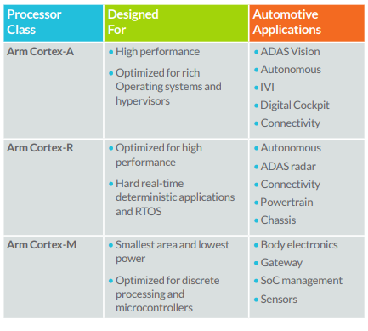
Classes of Arm Processors for Automotive

Slide 71
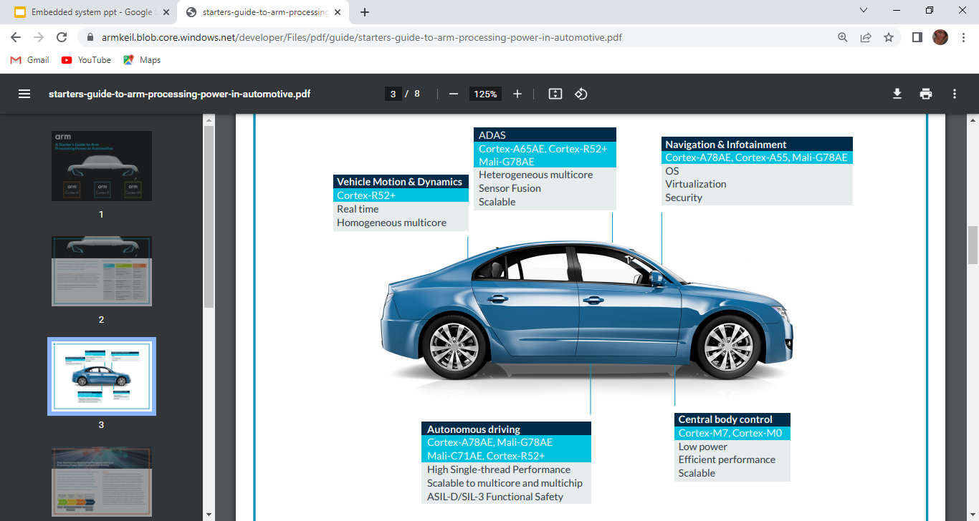

Slide 72
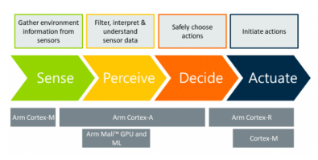
Depending on type and class, these ADAS systems can be powered by a combination of Cortex-A, Cortex-R, and Cortex-M processors.
Arm categorizes the application of processing power in the following four stages for autonomous processing:

Slide 73
Sense:
This stage involves gathering information about the environment through a range of sensors.
Depending on the type of sensor, the data collection systems within the vehicle can be powered by Cortex-A, Cortex-R, or Cortex-M processors.
Perceive:
In the perceive stage, the system is filtering and interpreting the data, to understand what can be learned about the environment from the sensor data.
The types of workloads seen in this stage are throughout sensitive which is why the Cortex-A processors play a predominant role here.

Slide 74
Decide:
During the decide stage, the system safely chooses the correct action for the vehicle to take.
There are increased levels of performance, latency sensitivity, and safety required.
The Cortex-R52+ is a good example of this due to its focus on redundancy and determinism.
Actuate:
The actuate stage is where the vehicles dynamic behavior is modified by the decision reached in the earlier processing stages.
At this point, messages are distributed across the vehicle that require deterministic behavior and real-time responsiveness.
Cortex-R is a natural fit for this step in the processing pipeline.

Slide 75
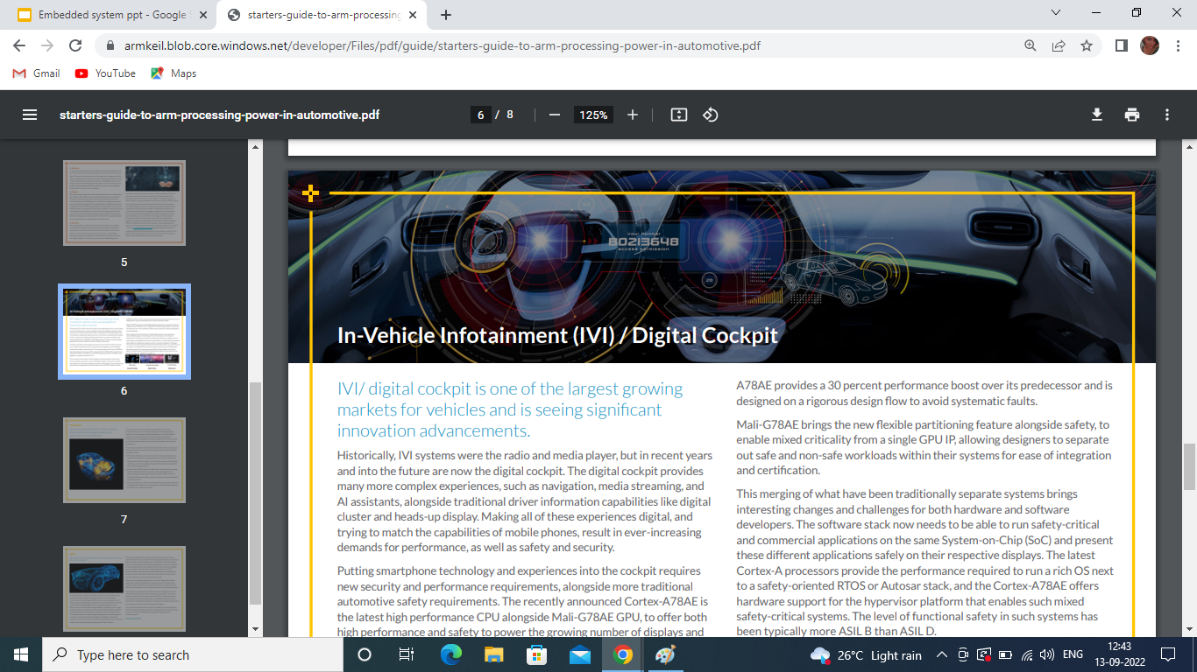
IVI/ digital cockpit is one of the largest growing markets for vehicles and is seeing significant innovation advancements.
The digital cockpit provides many more complex experiences, such as navigation, media streaming, and AI assistants, alongside traditional driver information capabilities like digital cluster and heads-up display.
The recently announced Cortex-A78AE is the latest high performance CPU.
Alongside Mali-G78AE GPU offers both high performance and safety to power the growing number of displays and graphics complexity within the car.
The inclusion of the cluster, which displays instrumentation and control for the vehicle’s operation, mean that digital cockpit systems have mixed criticality from a functional safety perspective.
Moreover, these systems also demand increasing levels of performance.
Cortex-A processors provide the performance required to run a rich OS next to a safety-oriented RTOS.

Slide 76

SAMPLE PROGRAMS
By
M.Bhargav Rohit

Slide 77
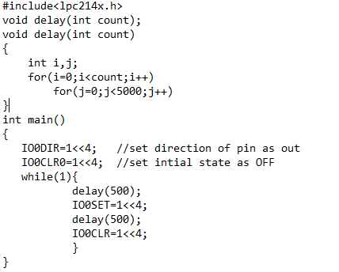
Toggling the LED connected to port PO.4

Slide 78
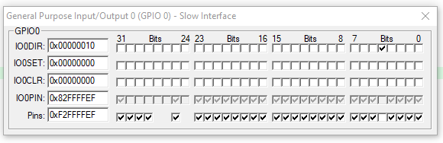
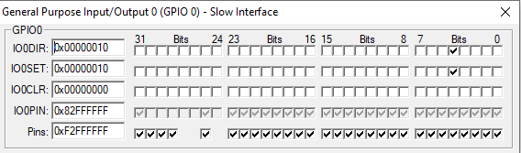
Simulator Output:

Slide 79
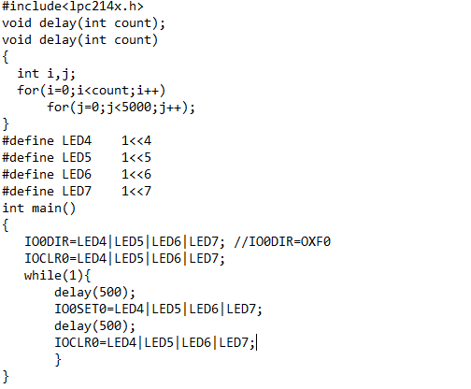
Toggle multiple LED

Slide 80
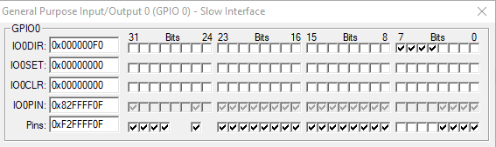
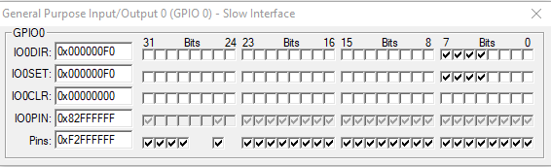
Simulator Output:

Slide 81
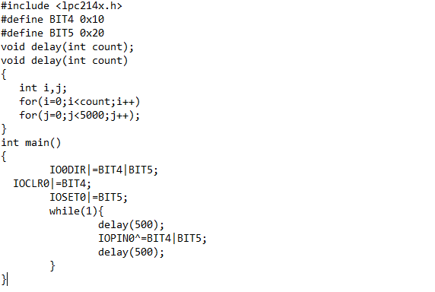
Compliment the LEDs connected to P0.4, P0.5

Slide 82
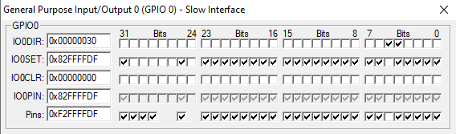
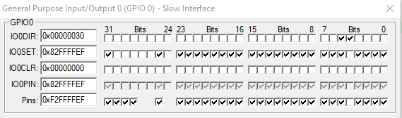
Simulator Output:

Slide 83
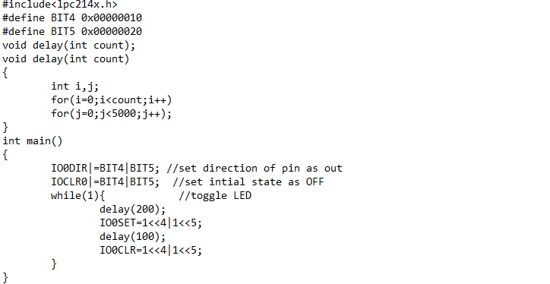
Simultaneous LED blinking using time delay

Slide 84
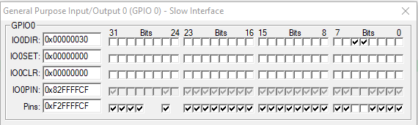
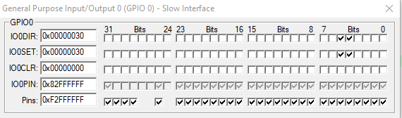
Simulator Output:

Slide 85
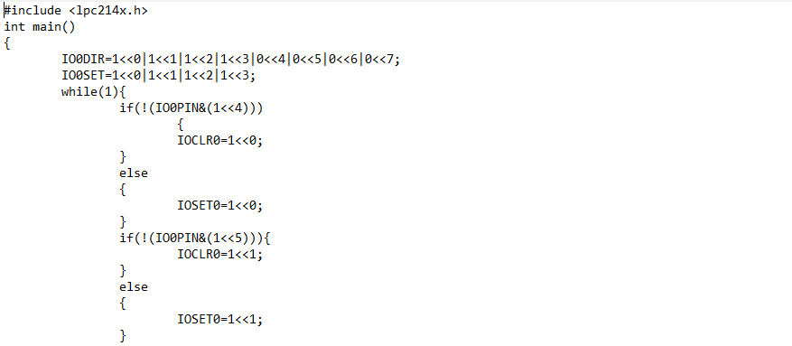
Toggle LED using multiple switch

Slide 86
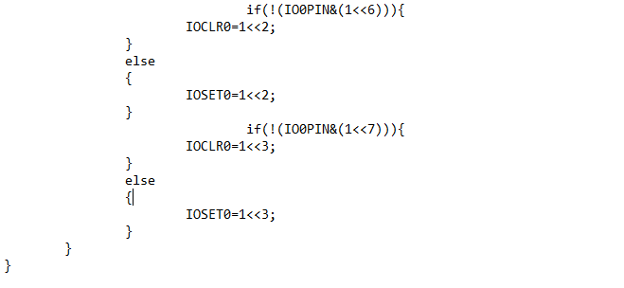

Slide 87
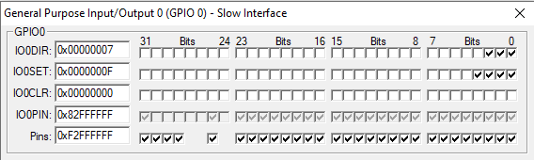
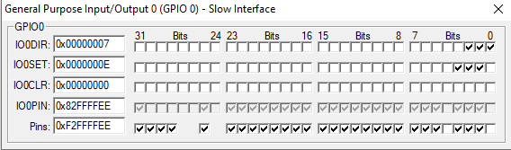
Simulator Output:

Slide 88
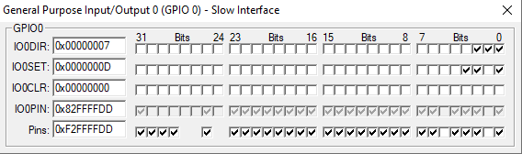


Slide 89
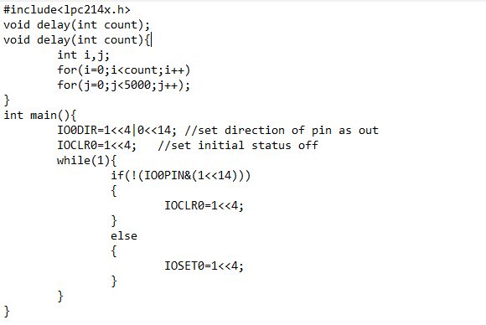
Toggling LED connected to P0.4 and switch connected to P0.14

Slide 90
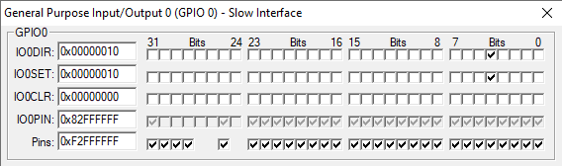
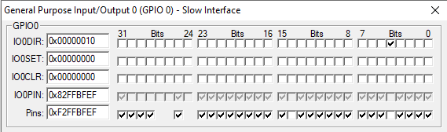
Simulator output:

Slide 91
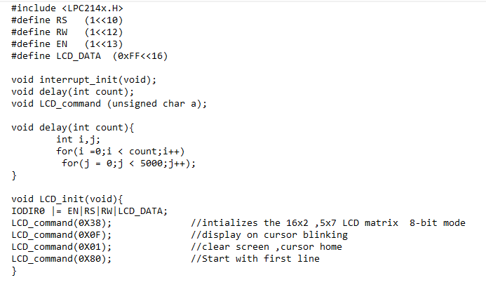
Print message on 16x2 LCD

Slide 92
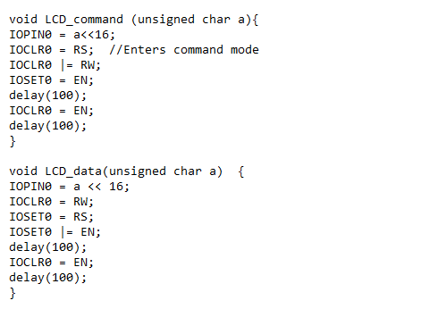

Slide 93
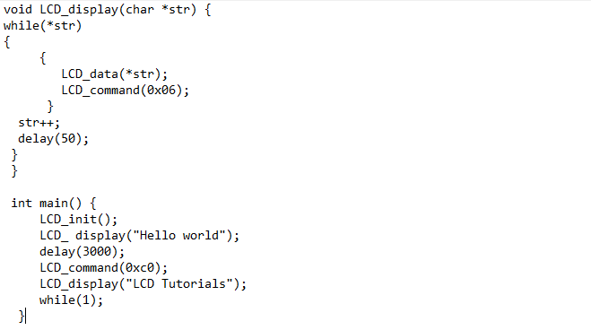

Slide 94
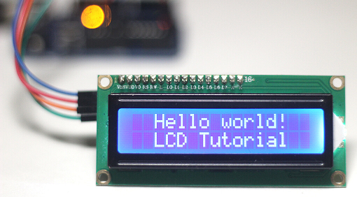
Simulation output

Slide 95
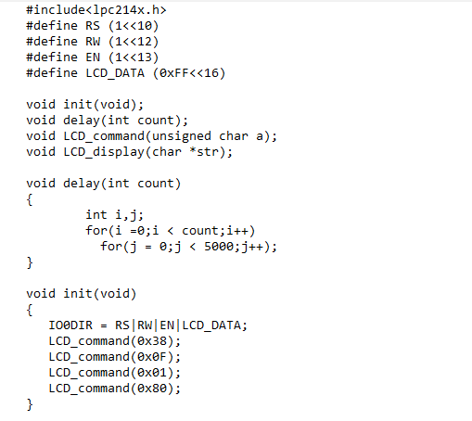
Implement left scrolling message on LCD

Slide 96
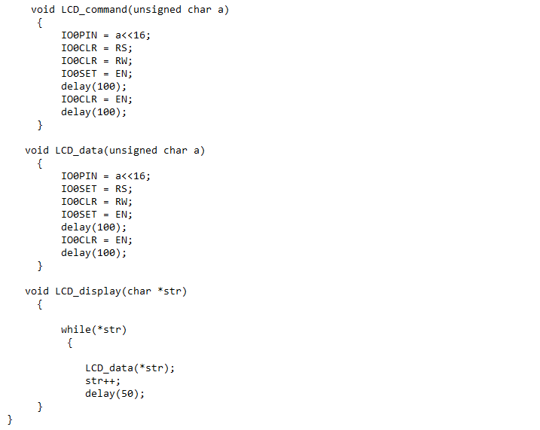

Slide 97
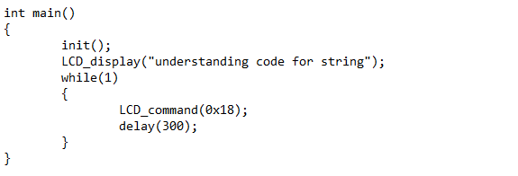

Slide 98
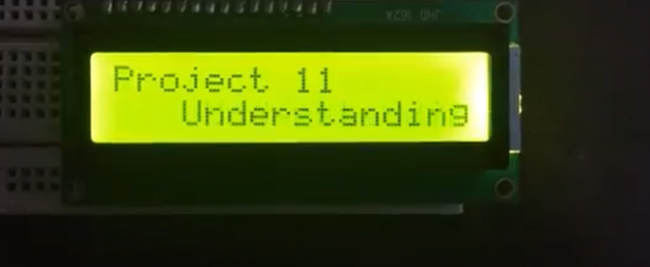
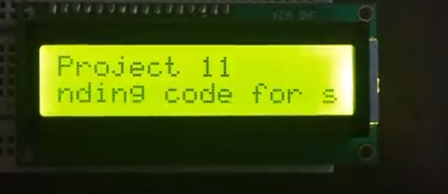
Simulation output

Slide 99
THANK YOU

